Slide 1
Batch Processing Using Spring Batch

Slide 2
1.What is Batch Processing?
2.What is Spring Batch?
3.How we implement Batch Processing with Spring Batch?

Slide 3
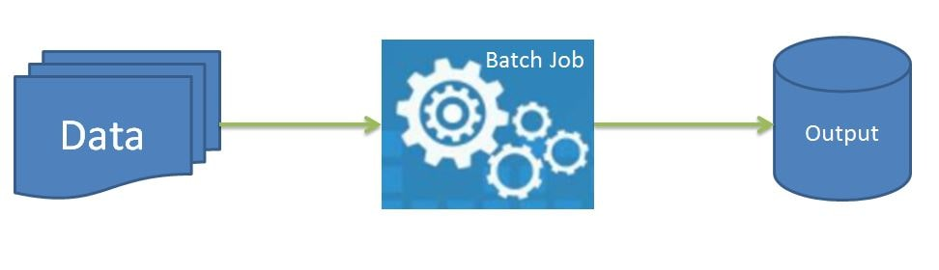
Batch Processing:
Batch Processing is a method for processing large amounts of data in a consistent manner. The batch method allows users to process data with little or no user interaction. These jobs can be scheduled based on the availability of resources.

Slide 4
Batch jobs help process a large amount of data. So the output might not be immediately available. Still there is always some deadline defined for batch jobs. For example some batch jobs related to payroll data of an organization need to be processed by 30th or 31st i.e. last day of every month so that bank can be notified to process the salary amount on the 1st. Also some batch jobs need to be run when there is less load on the system. For example there are many nightly and weekend batch runs done in banks when the system load is less.

Slide 5
Key Features of Batch Processing:
Batch Processing has become popular due to its numerous benefits for enterprise data management. It has several advantages for businesses:
Efficiency: Batch Processing allows a company to process jobs when computing or other resources are readily available. Companies can schedule batch processes for non-urgent tasks and prioritize time-sensitive tasks. Batch systems can also run in the background in order to reduce processor stress.
Simplicity : Batch Processing is a less complex system that does not require any special hardware or system support. It requires less maintenance for data input.
Faster Business Intelligence: Batch Processing enables businesses to quickly process large volumes of data which results in faster and efficient Business Intelligence. In Batch processing, many records can be processed at once which reduces the processing time and ensures that data is delivered on time. Additionally, since numerous jobs can be handled simultaneously, Business intelligence is available faster than earlier.
Improved Data Quality: By automating most or all components of a processing job and minimizing user interaction, batch processing reduces the likelihood of errors. Precision and accuracy are improved to achieve a higher level of data quality.

Slide 6
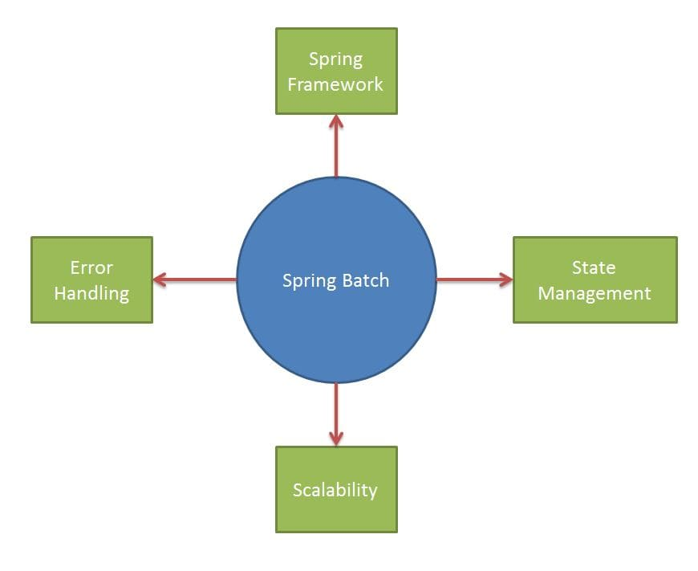
Spring Batch:
Spring Batch is the de facto standard for batch processing on the JVM. Spring Batch is a lightweight, open source framework for executing batch jobs. The Spring Batch framework (Spring Batch) was developed to implement common batch patterns and paradigms.

Slide 7
Key Features of Spring Batch :
Built on top of Spring Framework - A developer can also execute batch job by writing code from scratch. However this will need a lot of efforts. Spring Batch is based on the Spring Framework which is a popular enterprise framework with features like dependency injection. Spring Batch is open sourced and provides ready to use functionalities which are being used widely and thoroughly test.
State Management - When running a job using spring batch, the job is usually broken down into logical steps and executed accordingly. All the states of these steps are persisted using spring batch. So we know the exact status and other metadata related to the job.
Error Handling - As we discussed previously batch jobs are usually run overnight without any external interruptions. So if any exceptions were to occur it should be handled by the spring batch framework itself. Spring batch provides robust error handling.
Scalability - Spring batch provides a number of ways like partitioning, remote chunking, parallel steps etc to achieve scaling.

Slide 8
Spring Batch Architecture
Following are the main building blocks of spring batch
Job
Job Instance
Job Execution
Job Launcher
Job Repository

Slide 9
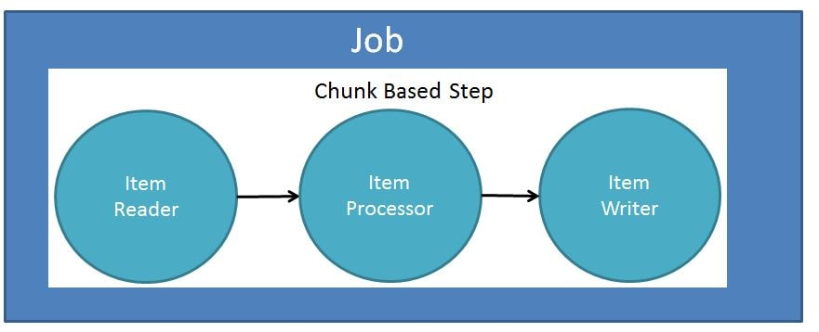
Job - Job can be defined as the work to be executed using spring batch. This work might involve a simple or complex task.

Slide 10
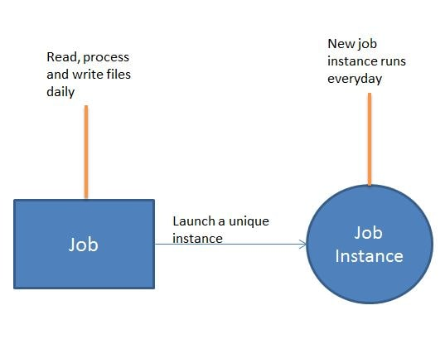
Job Instance - When a spring batch job is run, a JobInstance gets created. The JobInstance is a logical run of the job. Each JobInstance is identified by the job name and the parameters passed to a job. For example if we schedule a batch job to run every day, then a new JobInstance will be created everyday for each run.

Slide 11
JobLauncher - The Spring Batch JobLauncher interface is an interface used to launch Spring Batch Jobs. Spring Batch JobLauncher has a single method - run(Job job, JobParameters jobParameters).
It takes two parameters
Job to be executed.
JobParameters to be passed to the Job
Job Repository - One of the important features of spring batch is state management. This is achieved using the Job Repository. Suppose a spring batch job was running and an error occurs. How does spring batch know that an error has occured and the job needs to be rerun. Important aspect of Spring Batch is that there should be no external interferance. So we need to save state of the job and future executions should take this into considerations. State Management is an important aspect when processing large volumes of data. This is achieved using Spring Batch JobRepository.

Slide 12
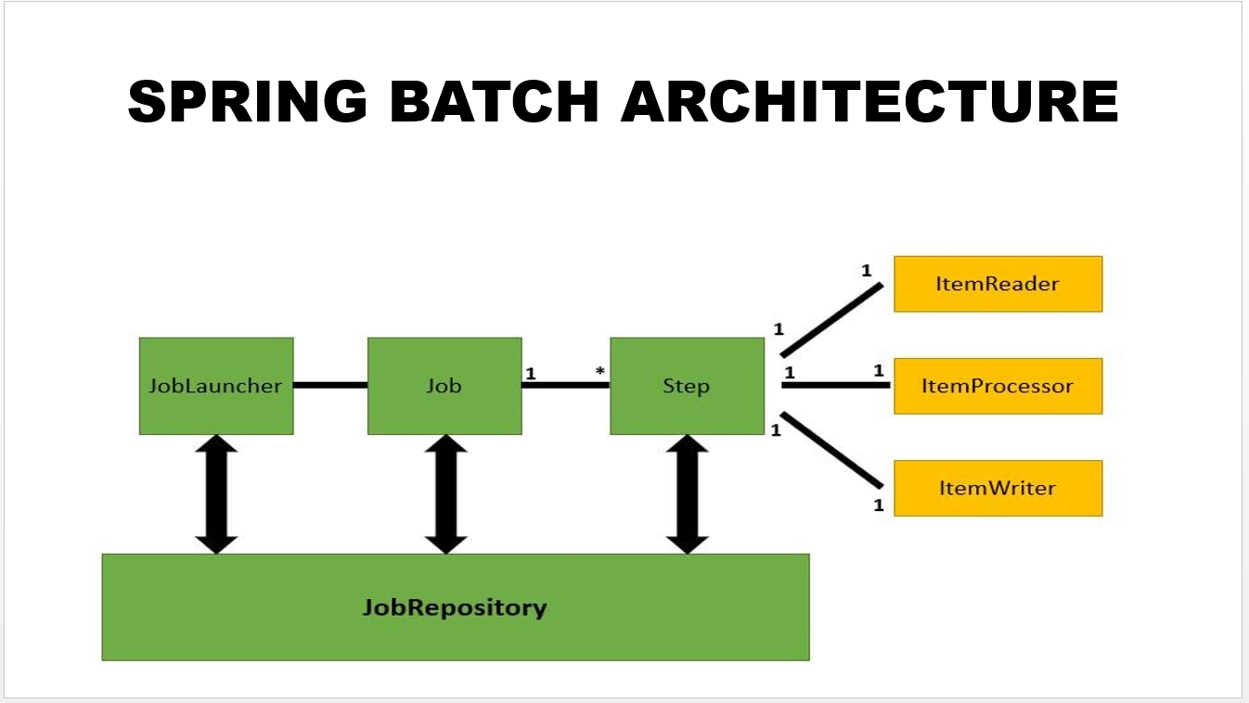

Slide 13
MetaData:
BATCH_JOB_INSTANCE Table - A single job instance is created when the job is executed for the first time with a unique set of identifying job parameters. It persists the logical run of a job.
BATCH_JOB_EXECUTION Table - This table represents every physical run of a batch job. Each time a job is launched, a new record will be created here and be updated periodically as the job progresses.
BATCH_JOB_EXECUTION_CONTEXT Table - Batch processes are stateful by their nature. They need to know what step they are on. They need to know start, end and status of the job.This is done using this table.
BATCH_JOB_EXECUTION_PARAMS Table - This table is where the job parameters are stored for each execution.
BATCH_STEP_EXECUTION Table - used to store the metadata for a step
BATCH_STEP_EXECUTION_CONTEXT - They need to know how many records they have processed within that step.

